Slide 1

Notation
Sums and recurrences
Manipulation of sums
Multiple sums
General Method

Slide 2


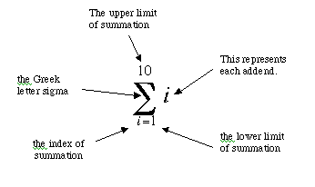

Slide 3





1
2
3
4

Slide 4




Compute the sum for
What is the first sum?
Then second one?

Slide 5

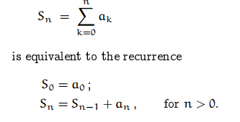
Therefore we can evaluate sums in closed form.

Slide 6

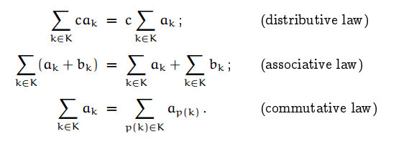


Slide 7




Slide 8
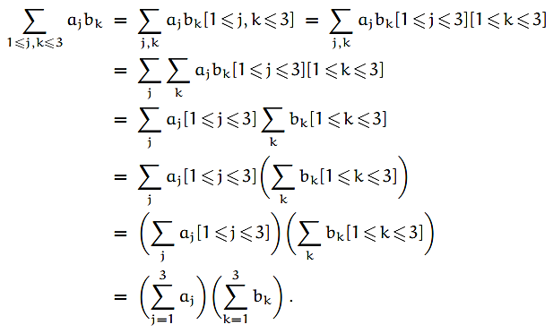

Slide 9


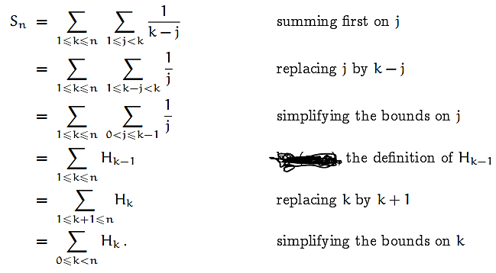

Slide 10

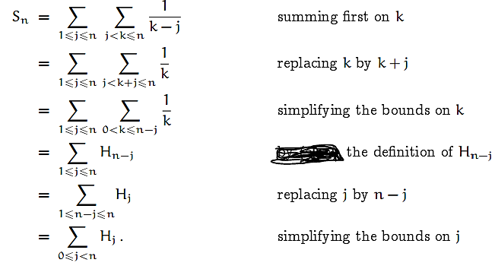

Slide 11

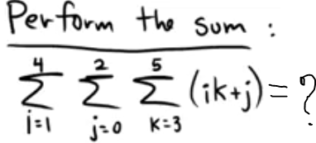
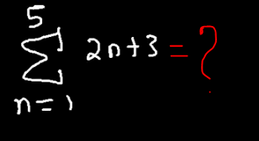

Find the sum
Find the sum

